Slide 1



AUTO ALERT FOR LAVATORY CLEANING
First Review
TEAM MEMBERS :
S.MOHANPRASATH
R.MANOJ
S.MANIKANDAN
G.JEEVA
GUIDED BY :
Dr.S.JEGADEESAN M.E., Ph.D.,

Slide 2
CONTENTS :
ABSTRACT
INTRODUCTION
PROBLEM STATEMENT
COMPONENTS USED
CIRCUIT DIAGRAM

Slide 3
ABSTRACT :
Toilets had become essential for mankind. But many diseases are also caused by toilets.
To avoid those diseases we monitor the usage of toilets and an alert message is sent to the concerned authorities by that they can make happen the required sanitation properly.
To monitor the usage of toilets an ultrasonic sensor is used, which gives the input to the Arduino in which a code is already given.

Slide 4
INTRODUCTION :
A public toilet, restroom, public bathroom or washroom is a room or small building with toilets (or urinals) and sinks for use by the general public.
Smart Public Toilet is an IoT and AI-enabled governance platform that enables Urban Local Bodies and schools to improve toilet cleaning and standardization of toilet hygiene.

Slide 5
PROBLEM STATEMENT :
Using a public toilet gives many people the jitters.
There's no refuting the fact that public toilets harbour plenty of bugs.
Germs can inhabit the seat, the floor, the sink, as well as surfaces you touch with your hands the doorknob, the flush handle, the tap handle, the dryer, etc ….

Slide 6
COMPONENTS USED :
Ultrasonic sensor
Arduino UNO
SIM800L

Slide 7
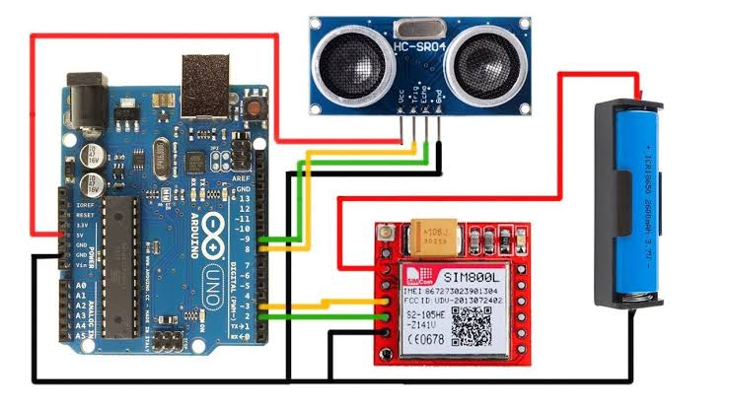
CIRCUIT DIAGRAM :

Slide 8
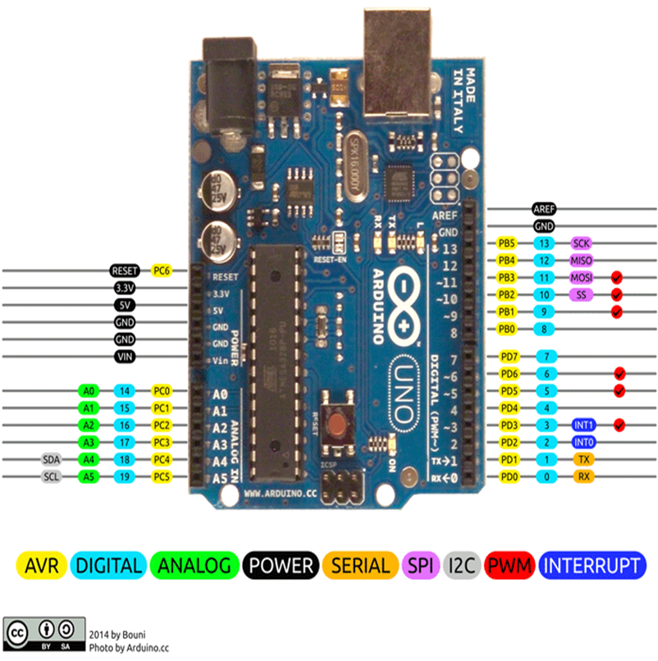
Arduino UNO :
The hardware structure of Arduino Uno : Microcontroller 14 Digital Pin 6 Analog Pins Power Supply Power Jack USB Port Reset Button

Slide 9
I. The Arduino Uno is an open-source microcontroller board based on the Microchip ATmega328P microcontroller and developed by Arduino.cc and initially released in 2010. II . The board is equipped with sets of digital and analog input/output pins that may be interfaced to various expansion boards and other circuits.

Slide 10
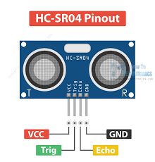
ULTRASONIC SENSOR :
An ultrasonic sensor is an electronic device that measures the distance of a target object by emitting ultrasonic sound waves, and converts the reflected sound into an electrical signal.

Slide 11
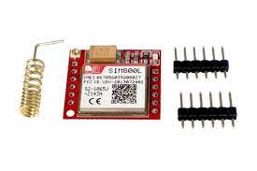
SIM800L :
SIM800L is a miniature cellular module which allows for GPRS transmission, sending and receiving SMS and making and receiving voice calls.

Slide 12


